Slide 1
1.4
History of Bitcoin - Part 1
Blockchain
Md. Atik Shahriar
Junior Software Engineer, Dynamic Solution Innovators (DSi)
Graduate, Computer Science and Engineering, Shahjalal University of Science and Technology

Slide 2
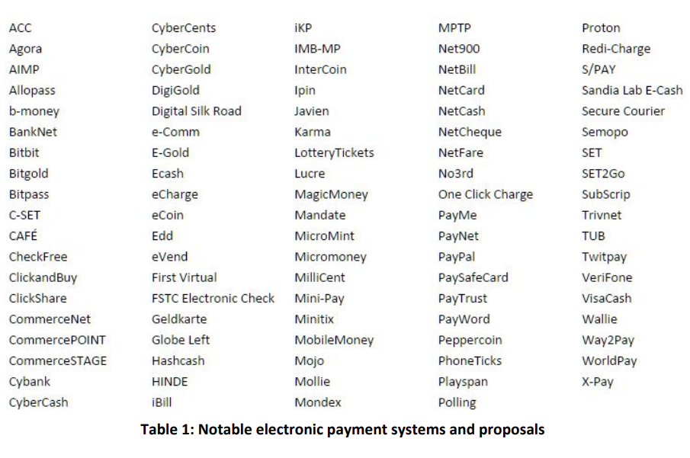
100 Digital Payment Systems

Slide 3
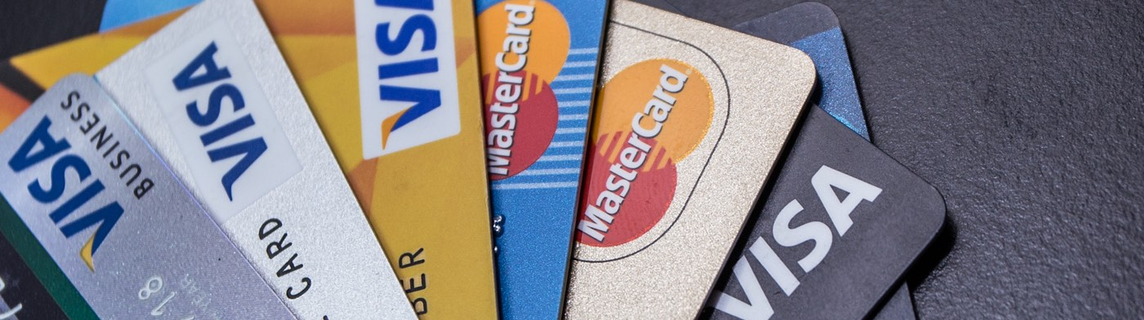
Credit Cards / Debit Cards
American Express
MasterCard
VISA
Discover
Source: Citi India

Slide 4
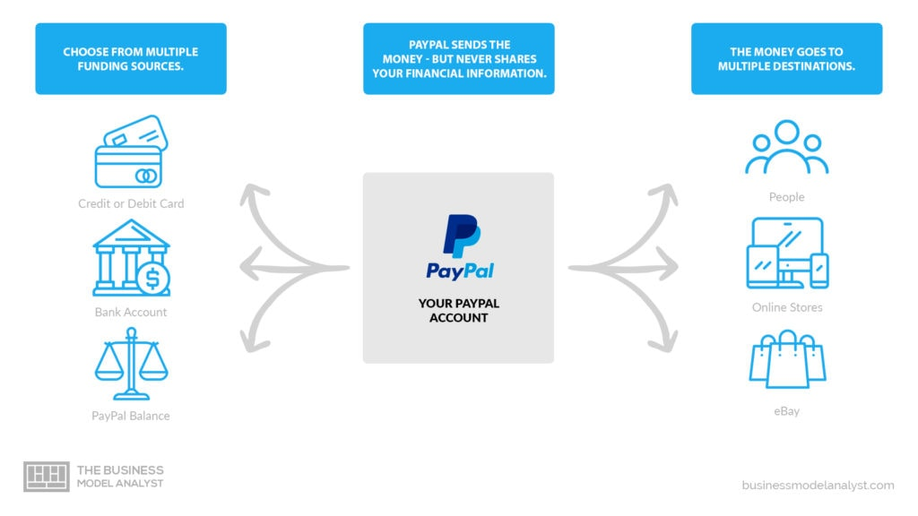
PayPal
Works as an intermediary between you and a bank
Protects your sensitive bank informations
Just share a Paypal link to receive or send money
Source: The Business Model Analyst

Slide 5
Back to the ’90s
Internet was not so secure
No HTTPS (no protocol-level encryption)
Too risky to share credit card / debit card informations over internet

Slide 6
Some Early Endeavours
FirstVirtual (1994)
Was a little like PayPal’s current system
All of the communications happened over email as it was more safer than HTTP protocol
The customer would have ninety days to dispute the charge
The merchant would receive the money only after three months

Slide 7
SET architecture
From the mid ’90s
A standard developed by VISA and MasterCard, together with Netscape, IBM, Microsoft, Verisign, and RSA
No need to enroll with the intermediary
An application encrypts the transaction details together with your credit card details
Only the intermediary can decrypt it
The seller blindly forwards the encrypted data to the intermediary along with their own view of the transaction details
The intermediary decrypts the data and approves the transaction if both view matches

Slide 8
CyberCash
Implemented SET architecture
A micropayment system (intended for small payments)
They had a digital cash product called CyberCoin
One of the few companies affected by the Y2K bug
Went bankrupt in 2001
Their intellectual property was acquired by Verisign
Verisign turned around and sold it to PayPal where it lives today

Slide 9
Why didn’t SET work?
The fundamental problem has to do with certificates
CyberCash and SET put security before usability
They decided that all users of their system would have to get certificates
Over the decades, mainstream users have said a firm and collective NO to any system that requires end-user certificates

Slide 10
Digital Cash
In 1983, David Chaum came up with the earliest ideas of applying cryptography to cash
Uses “blind signature” method
Requires a server run by a central authority whom everyone trust
Every transaction needs the participation of this server to go through
If the server goes down temporarily, payments grind to a halt

Slide 11
Digital Cash
In 1988, David Chaum with two other cryptographers Fiat and Naor proposed offline electronic cash
Stop worrying about preventing double-spending and focus on detecting it
Every digital coin issued to you encodes your identity that only you can decode
Every time you spend your coin, the recipient will require you to decode a random subset of the encoding
In case of double spending the bank can put the two pieces of information together to decode your identity completely, when both recipients will go to the bank to redeem their notes
There’s no way to split a cash

Slide 12
Digital Cash
A paper by Okamoto and Ohta uses “Merkle trees” to create a system that does allow you to subdivide your coins
Chaum took his ideas and commercialized them by forming a company called DigiCash in 1989
The actual cash in Digicash’s system was called Ecash and they had another system called cyberbucks
Many banks from US and Finland actually implemented it
Clients in ecash are anonymous, but merchants aren’t
Chaum had several patents on Digicash technology, specially the blind-signature scheme

Slide 13
Digital Cash
A bunch of cryptographers who hung out on what was called the cypherpunks mailing list wanted an alternative
They implemented a version of ecash called MagicMoney
It was billed as being only for experimental use
Transactions could be sent by email

Slide 14
Digital Cash
Ben Laurie along with many other people proposed a non-patent-encumbered alternative to the blind-signature scheme called Lucre
Another proposal by Ian Goldberg tried to fix the problem of not being able to split coins to make change

Slide 15
Why did DigiCash fail?
It was hard to persuade the banks and the merchants to adopt it
It didn’t support user-to-user transactions

Slide 16
Tamper-resistant Hardware
In the later years, DigiCash experimented with tamper-resistant hardware
The goal was to try to prevent double-spending rather than just detecting it
The hardware was a wallet, or some sort of card, that would keep track of your balance using a counter
There should not be any way to physically or digitally go in and tamper with its counter
DigiCash later worked with an Europe-based company called CAFE
Another company, Mondex, also worked with the same idea which was then acquired by MasterCard. VISA also had their own VisaCash

Slide 17
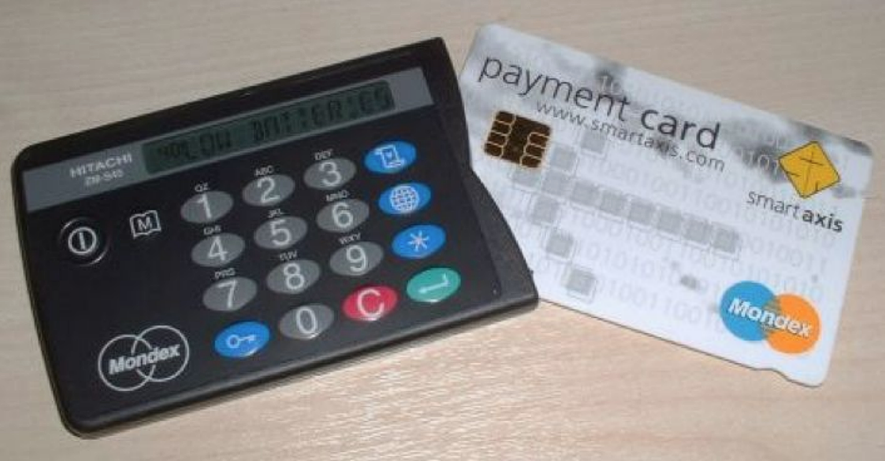
Mondex

Slide 18
Mondex
There was a smart card and there was a wallet unit, both could be loaded with cash
Money could be transferred between the wallet and card
User-to-user swap of money was possible usine the wallet

Slide 19
Problems with Mondex
If you lose them or they get stolen, the money was gone
In case of malfunction, there was no way to figure out if that card had balance on it or not
The wallet was slow and clunky

Slide 20
Legacy of Mondex
Mondex cards were smart cards with small microcontrollers (chip) on them
This technology survived and is being used with all credit/debit cards nowadays
However, the chip is used for authentication rather than keeping track of balance

